Slide 1


PRESENTATION
Final Project analysis
E-Commerce Shopping Cart
Presented by Group G,Team 3

Slide 2



Our Team
Kevin Santoso
Mardawaning Hanggarjita
Nadhifa Putri
Artanti

Slide 3
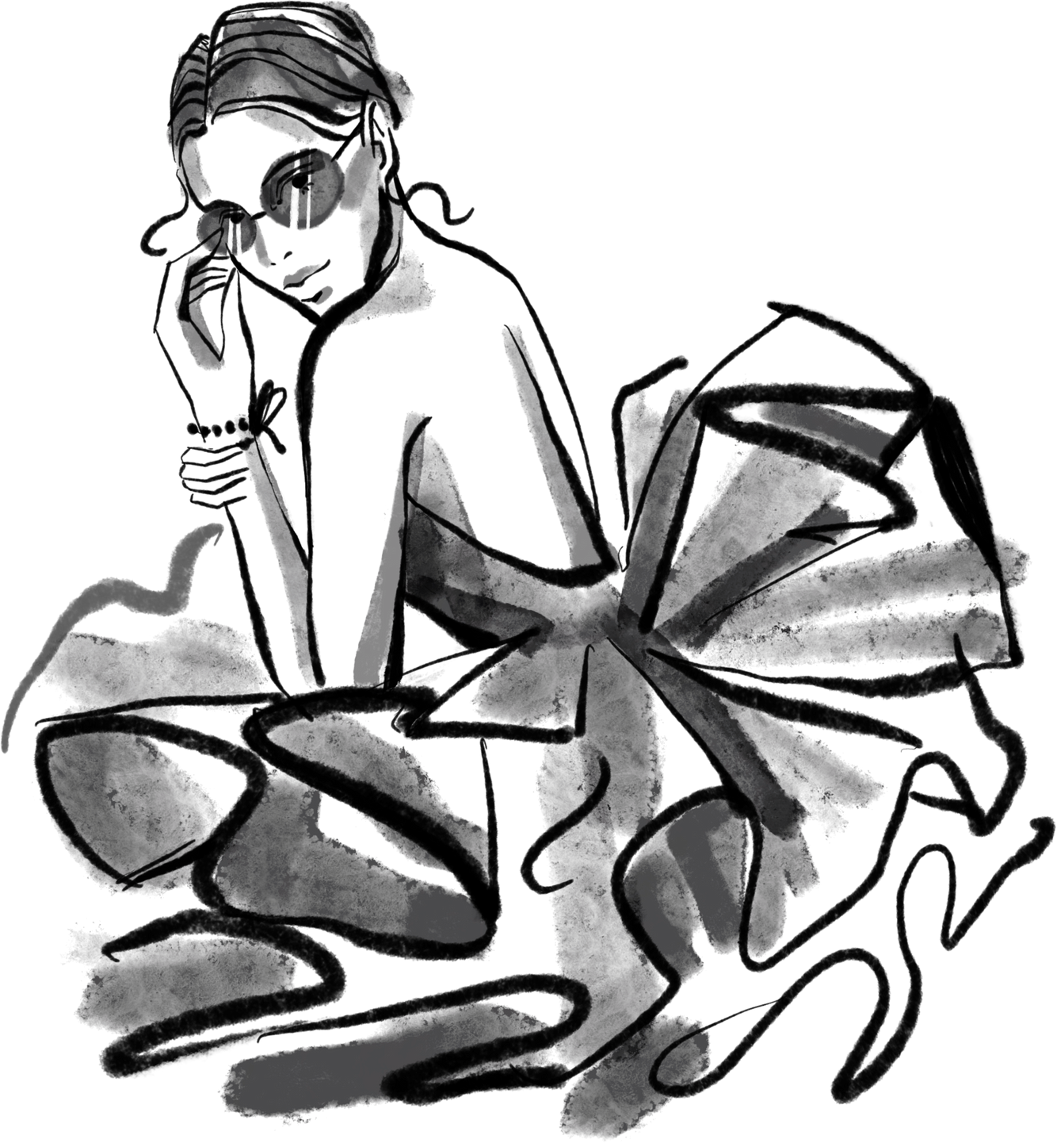
Overview
Project Goals
Data exploration
Insight & Recommendations
Table of content

Slide 4
Overview

Slide 5
Methodology
Data Preparation
2.Data Cleaning
3. Data
Analysis
4. Data
Visualization
5. Recommendation

Slide 6
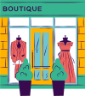





Australian
Based
Customers spanned through the whole of Australia.
From Queensland to Victoria.
Clothing store sales data
$1,038,327
Total Revenue
Highlights
-
Total sales
The data is related to the sales campaign of a certain clothing store from January - October 2021 with 617 total customer
9962
Product sold
Product sold

Slide 7
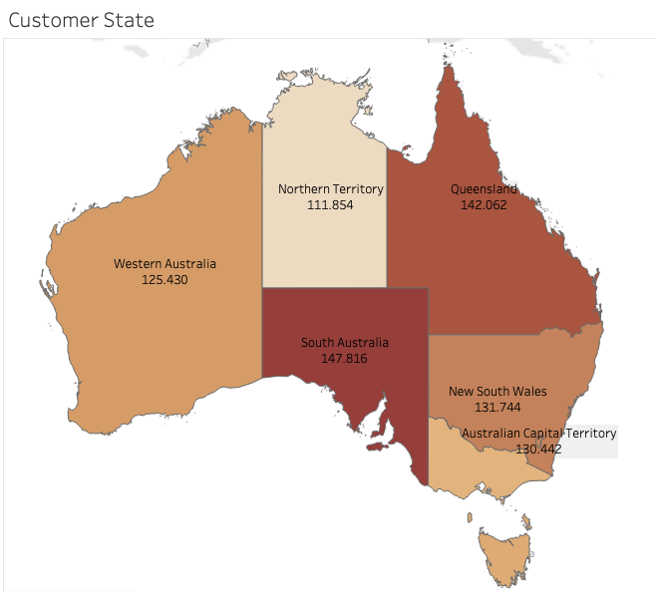
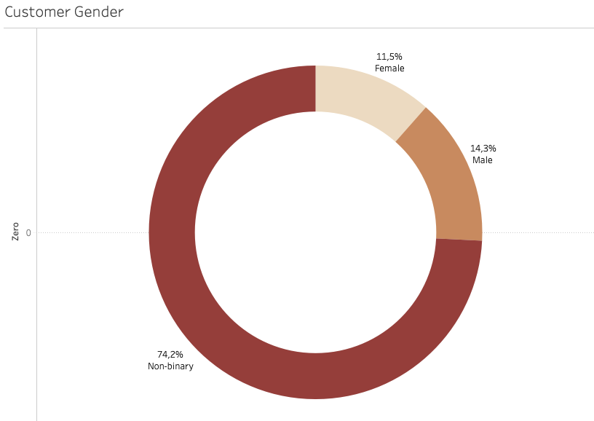
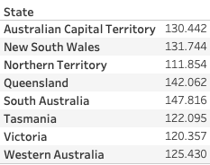
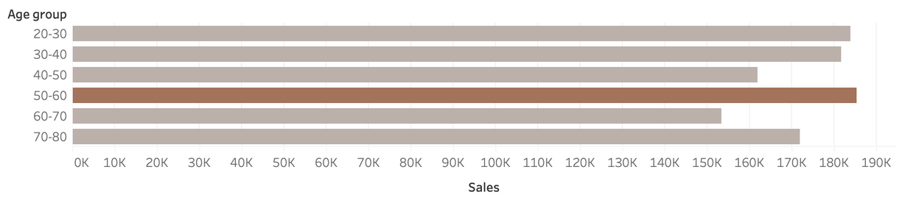
Customer Demographic
Our customers span throughout the whole of Australia, with ages ranging from 20 to 80, and have three categorical in genders.
While having a vast range of customers is excellent, we are still a growing business in an already crowded market.

Slide 8
2. Project
Goals

Slide 9
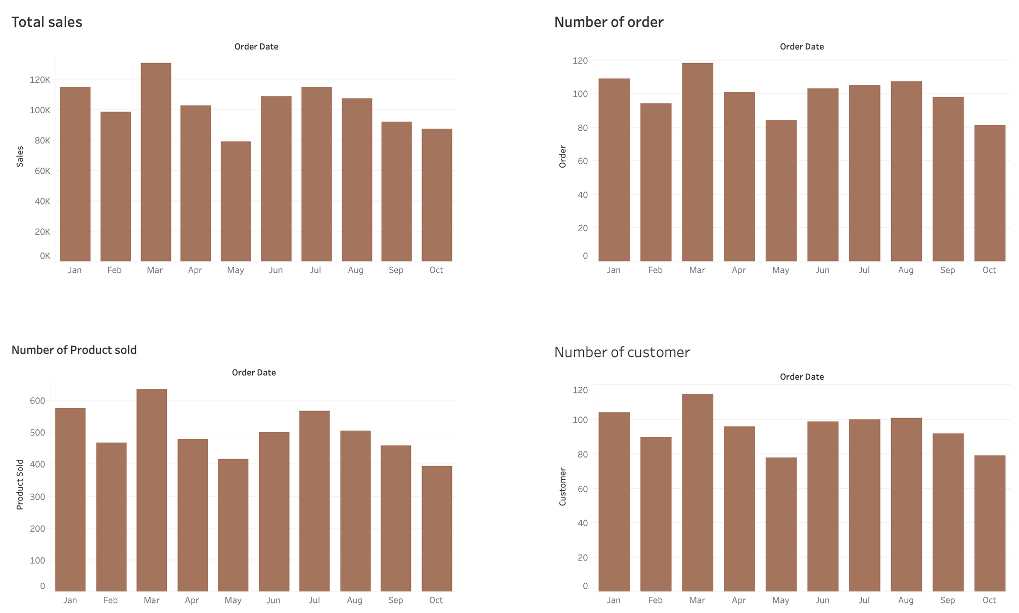
Financial Highlight

Slide 10
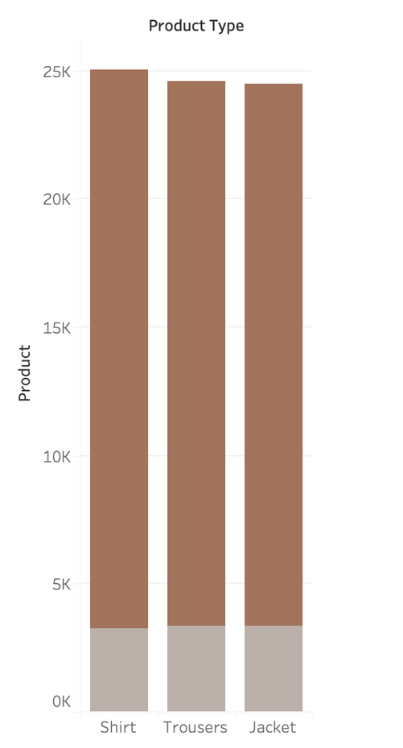
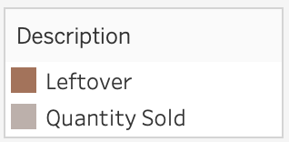
Overstock Problem
13.14%
Only 9,962 items are sold from 75,789 products in stock.

Slide 11
Objective
How to increase the percentage of sold products to 40%
by the end of 2022 & manage overstock products that we found in our supplies?

Slide 12
3. Data Exploration

Slide 13
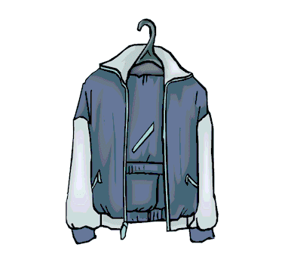
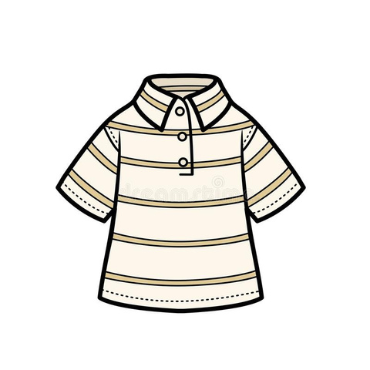
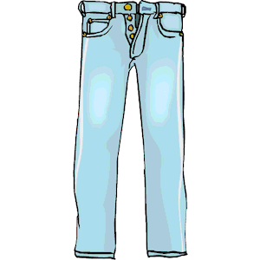
Product Variations
We have 1233 product variations and 35 Products from 3 product types
We assume that we have too much product variations
Jacket
Shirt
Trousers

Slide 14
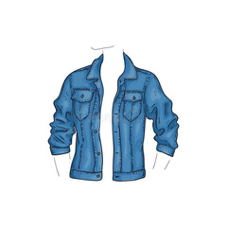
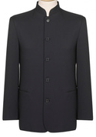
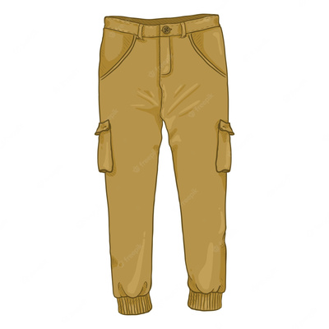
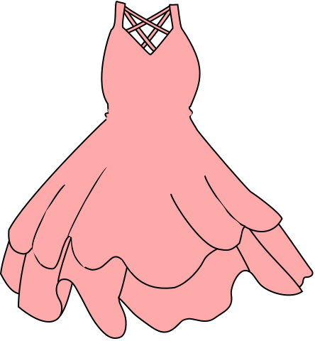
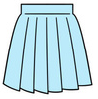

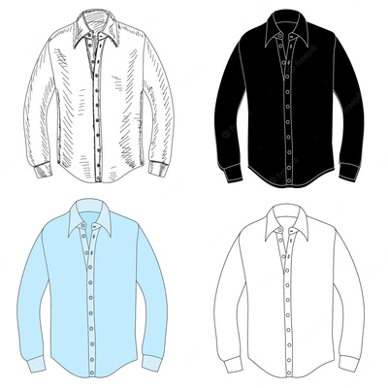
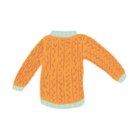
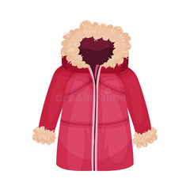
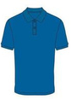
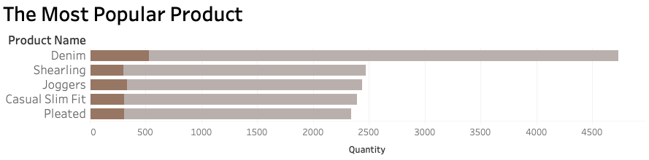
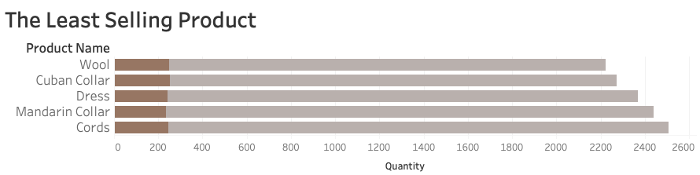
The Most Popular Selling Product
The Least Selling Product
Denim
Joggers
Pleated
Casual Slim Fit
Shearling
Mandarin Collar
Dress
Cords
Wool
Cuban Collar

Slide 15
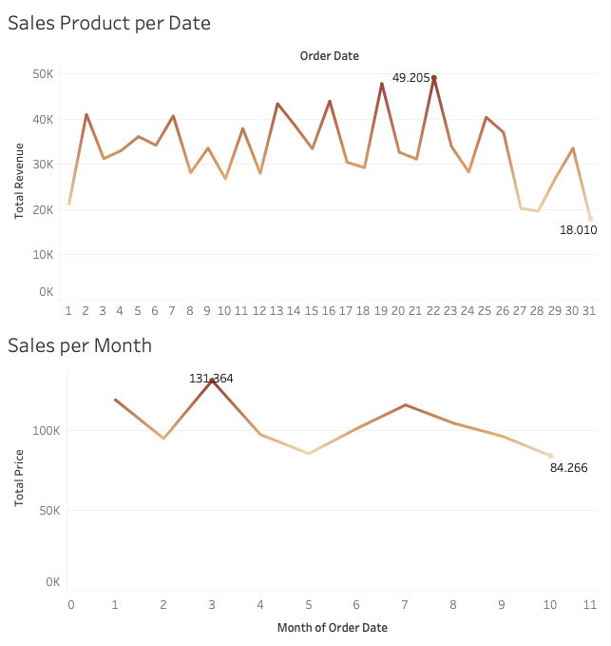




Highest Sales
Average Sales
206,4
Sunday is the highest sales per week day
Every 22nd of every month is the highest sales with total revenue 49.205 AUD
March is month with the highest sales with total revenue 131.364 AUD
Winter is the season with highest sales (June, July, August)

Slide 16
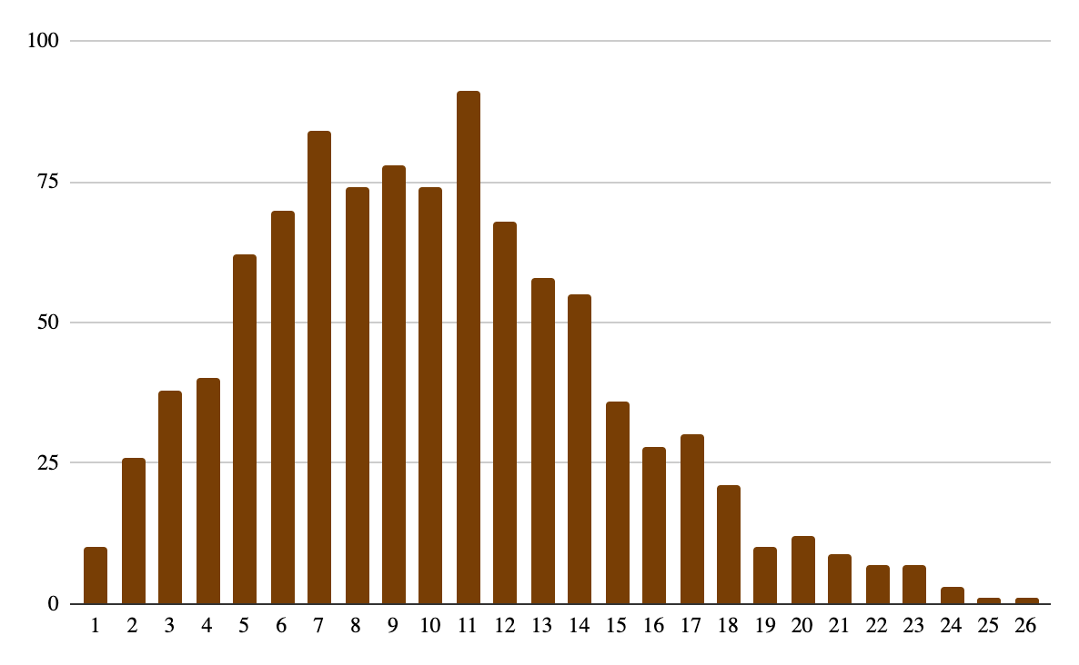
Number of Item Purchases per Order
During the ten months period of January to October 2021, the number of item purchases per order was relatively high, with an average of 10.03
Number of orders
Items per order

Slide 17
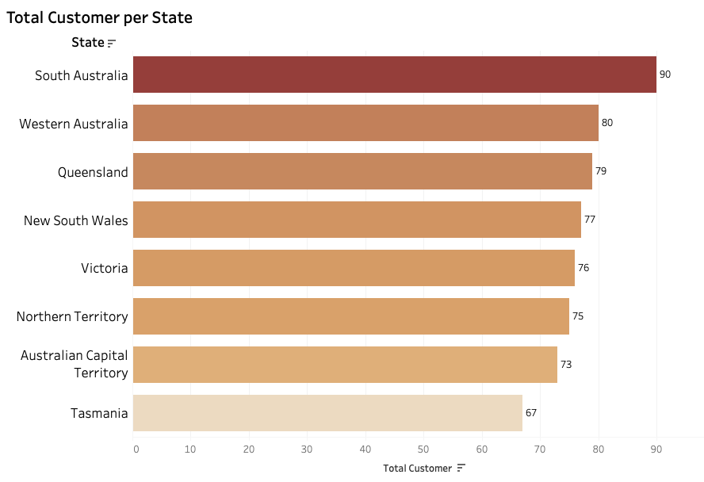
Customer from all over Australia
Though we previously said that we need to do targeted marketing, we still need to applaud our marketing team for getting customers from all over Australia
Top 5 states
South Australia ~ 90
Western Australia ~80
Queensland ~ 79
New South Wales ~ 78
Victoria ~ 76

Slide 18
4. Insight & Recommendations

Slide 19
Insight
Our customers span throughout the whole of Australia, but still need to increase the number of customer
We have too many variation product types. The least five are mandarin collar, dress, cords, wool, and cuban collar
The number of item purchases per order is pretty good, with around ten items per order.
The highest sales occurs in March, Sunday, Every 22nd of every month, and Winter

Slide 20
Recommendations
Membership and referral program
Promotion to increase brand awareness in few specific cities.
Discount or cashback for repeat purchases.
Develop a marketing campaign that targets a specific segment in the market
Increase the number of customer
Bundling the top five least-selling items with most selling items
End-of-season special bundle
Giveaway to increase brand awareness
Develop a marketing campaign that addresses the problems in overstock
2. Too much variation types

Slide 21
Recommendations
Special sales in time when previously highest sales occurs
Happy hour
Discount, cashback or free delivery for big spender
Develop a Marketing campaign and activity by leveraging the positive insight.
3. Leverage Positive takeaways

Slide 22
Appendix
Data: https://www.kaggle.com/datasets/ruchi798/shopping-cart-database?select=sales.csv
https://colab.research.google.com/drive/1Gbjq3eC7ccudd0COCG7EPgkGJ9gYXpJ8
https://public.tableau.com/app/profile/nadhifa.putri.artanti/viz/GFP3G/Dashboard1?publish=yes

Slide 23
Thank you

